Slide 1
Automated Data Quality Framework for Real-Time Pipelines

Slide 2
Aim and flow of project
Aim is to be build a automated system to maintain the data quality in real time distributed environment.
Batch Validations are slow and expensive
Framework should be able to identify data issues as soon as data flows through the system.
Will use Kafka for ingestion and detect anomaly using tested system.
Will implement Dead Letter Queue for future analysis.
Prevent the corrupt data to move to Data warehouse.
Match or improve the False Discovery Rate of the Batch Processing.

Slide 3
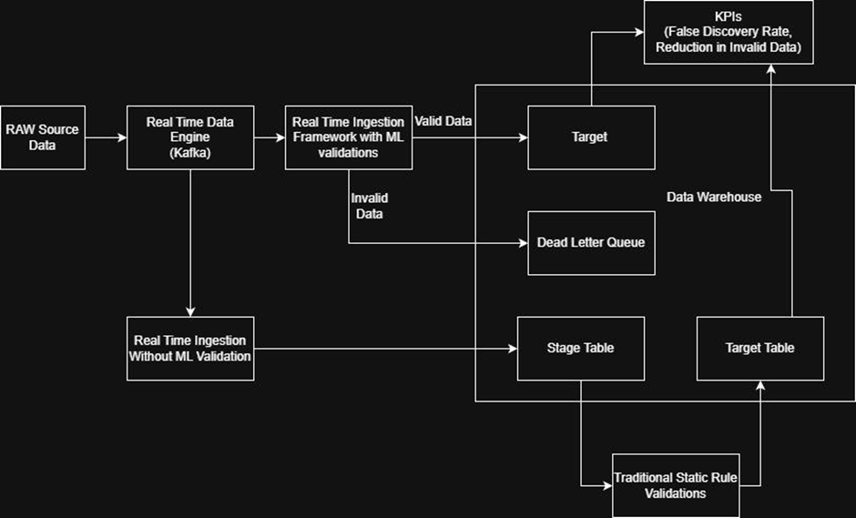
Block Diagram

Slide 4
Anomaly Detection in Streaming Data using Isolation Forest
https://ieeexplore.ieee.org/document/10571907/
In this paper, they have investigated the Isolation Forest Algorithm for streaming data anomaly. They adopted a sliding window approach for training instead of batch to be relevant with most recent data.
A data point which is isolated with a lower average path length is considered to be anomaly record.
This work already supports the Kafka Streaming, but is not implemented on it

Slide 5
Enhancing Real-Time Analytics Streaming Data Quality Metrics for Continuous Monitoring
https://dl.acm.org/doi/epdf/10.1145/3686592.3686609
This paper focuses more on the metrics of data
Instead of simply labelling data as ‘Good’ or ‘Bad’, it gives different metrics on the below dimensions
Timeliness ( Are we getting the data on time )
Accuracy ( Are we getting the right data )
Completeness ( Are we getting all the data )
Consistency ( Are the data according to standards set )
There are few mathematical formulas discussed. Which could be used for metrics in the future

Slide 6
Anomaly Detection for Automated Data Quality Monitoring in the CMS Detector (AutoDQM)
https://link.springer.com/article/10.1007/s41781-025-00147-2
This paper talks about designing the system for continuous high velocity system for telemetry data to prevent corrupt data from going to downstreams.
Statistical Testing : Beta Bionomial statistical test used against verified data
PCA : PCA based anomaly detected used to detect verified good runs.
It suggests Ensemble technique outperformed with False Positive Rate below 13%
This does not account for evolving schema and there is no DLQ.

Slide 7
Large-Scale Data Quality Challenges, Framework and Evaluation in Metro Systems
https://ieeexplore.ieee.org/document/10705079/
This paper has discussed about the Data Quality in Operational Metro Systems
They have implemented 3 failure models
Completeness Check Model (No Nulls), Statistical Outliers (using iForest Algoritm) and Semantic Corruption
They have defined 5 different quality metrics: Completeness Rate, Timeliness Index, Accuracy Rate, Consistency Rate, Semantic Validity.
These validations though are on streaming data, it is done once the data arrives to the warehouse.

Slide 8
Data Profile
Extracting the data of the Indian Stock Market for the top 100 stocks
Historical Will be using historical data for the FY 2025-26 to minute granularity.
A Script will be created to induce irregularity randomly.
Streaming For Real Time Processing as well, we will be using the same API and extracting the minute level data and will be subject to random irregularity inducing script.

Slide 9
Data Extraction in Progress
Leveraged the official high-fidelity API for programmatic access to historical market data via Python SDK integration.
Extracted the prices of 99 stocks
14 months of data was extracted

Slide 10
Simulating Anomalies
Created a script to inject noise randomly
Select a random record every 1000 to 1000th Record to inject anomaly
Select a random numeric column
Corrupt bt 5 to 10 times
Keeping track on the induced anomaly for validation
Stock and Date is not subject to corruption.

Slide 11
Feature Engineering
1m Returns : Captures Relative price movement.
High-Low Spread Percentage : Identifies how the stock price has moved in the minute
Volume Z Score : Feature used to find out how unusual a specific minutes trading volume.
Price Deviation Percentage : It measures how minutes closing price has stayed with the trend

Slide 12
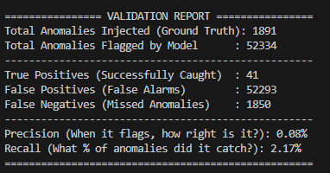
Validation Result

Slide 13
What could have gone wrong
The anomaly inducer script induced error on single feature.
Dropped the core features.
Improper Contamination Rate Selection
Sudden Rise and Fall of Price and Volume is the nature of markets.

Slide 14
Changes Implemented and Result
High Frequency variation can constitute to noise, hence tried a larger time frame features
Introduced the
Price Deviation percentage in an hour
Relative Price Change in 5 minutes
================ VALIDATION REPORT ================
Total Anomalies Injected (Ground Truth): 1891
Total Anomalies Flagged by Model : 52334
---------------------------------------------------
True Positives (Successfully Caught) : 345
False Positives (False Alarms) : 51989
False Negatives (Missed Anomalies) : 1546
---------------------------------------------------
Precision (When it flags, how right is it?): 0.66%
Recall (What % of anomalies did it catch?): 18.24%
===================================================

Slide 15
Changes Implemented and Result
Recall jumped from 2.17% to 18.24% (catching 345 anomalies instead of 41), and True Positives multiplied by nearly 8.5x.
Decreased the contamination_rate to 0.0005.
================ VALIDATION REPORT ================
Total Anomalies Injected (Ground Truth): 1891
Total Anomalies Flagged by Model : 5228
---------------------------------------------------
True Positives (Successfully Caught) : 1128
False Positives (False Alarms) : 4100
False Negatives (Missed Anomalies) : 763
---------------------------------------------------
Precision (When it flags, how right is it?): 21.58%
Recall (What % of anomalies did it catch?): 59.65%
===================================================

Slide 16
Changes Implemented and Result
Instead of forcing a hard-coded percentile cutoff via .predict(), we extract continuous anomaly scores via .score_samples()
Use the ROC Curve and found the Gmean to act a threshold.
================ VALIDATION REPORT ================
Total Anomalies Injected (Ground Truth): 1891
Total Anomalies Flagged by Model : 830318
---------------------------------------------------
True Positives (Successfully Caught) : 1481
False Positives (False Alarms) : 828837
False Negatives (Missed Anomalies) : 410
---------------------------------------------------
Precision (When it flags, how right is it?): 0.18%
Recall (What % of anomalies did it catch?): 78.32%
===================================================

Slide 17
Results Review
Good Recall, but Precision Fell
The G-Mean treats the True Positive Rate (Recall) and the False Positive Rate with equal mathematical weight.
Not Suitable for Imbalanced Dataset

Slide 18
Streaming SimulationArchitecture
Data Producer (Emitter) (Script: data_producer.py)
Loads historical market data chunks row-by-row into memory buffer.
Streams events to downstream consumers via local TCP socket on port 9999.
Configurable flow controller delay allows customizable real-time emulation speeds.
Live Consumer & Detector (Script: data_consumer.py)
Continuously ingests micro-streams via socket network listener.
Maintains localized sliding rolling memory windows per ticker symbol.
Performs instant inference using pre-trained detection models.
Publishes real-time anomaly alerts straight to target log registries.

Slide 19
Real-Time Feature Computation
Sliding Buffer Allocation
To maintain state without storing database tables, the stream pipeline allocates static in-memory sliding windows for rolling calculations.
Closing Price Window
Tracks short-term historical deviations
Trading Volume Window
Detects sudden liquidity & transaction surges
General Market State
Correlates asset shifts with market broad benchmark

Slide 20
Technical Implementation & Inventory
Network Communication Interface
Encapsulated payloads are serialized to JSON string arrays and dispatched over continuous TCP sockets with standard newline (`\n`) formatting delimiters.
Zero-Variance Feature Consistency
In-memory real-time sliding calculation utilizes identical formulas and standard deviations as the historic batch model, ensuring 100% test reliability.
Output Logging & Alerting
All detected anomalies are persistently logged to disk: logs/streaming_anomalies_*.csv.

Slide 21
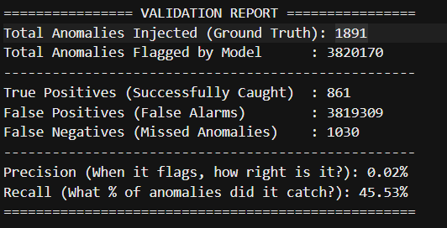
Experiment with LOF and OCSVM
Configured LOF with 20 neighbors and automated contamination thresholding over the 7-feature core matrix.
Configuration:
- n_neighbors: 20
- contamination: 'auto'
- Same 7 features as Isolation Forest
- ROC-based threshold optimization

Slide 22
Result of LOF and OCSVM
The result is bad compared to Isolation Forest
Isolation Forest: Precision 0.18%, Recall 78.32%, Time 11m 42s
LOF: Precision 0.02%, Recall 45.53%, Time 90m 45s
LOF underperformed significantly on this feature space, yielding massive computational overhead and excessive false positives

Slide 23
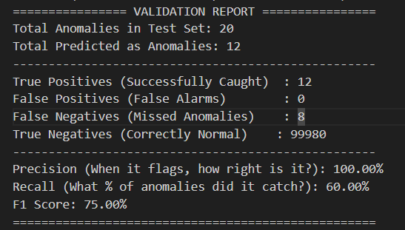
Shift Towards Supervised Learning
Created Labelled Dataset and applied Random Forest
Configuration:
- n_estimators: 100
- max_depth: 15
- min_samples_split: 10
- min_samples_leaf: 5
- class_weight: 'balanced'
- n_jobs: 1 (single thread)
- Same 7 features as Isolation Forest
- Train/test split: 80/20 (stratified)

Slide 24
Observations
Precision : Random Forest achieves a 100% precision score compared to Isolation Forest’s 0.18%, completely eliminating false flags.
The Recall: Random Forest missed 8 out of 20 anomalies in the test set, dropping recall from 78.32% to 60.00%.
Data Dependency: Random Forest requires explicit labeled history and training optimization on subsets, whereas Isolation Forest handles raw, unlabeled streams out of the box.

Slide 25
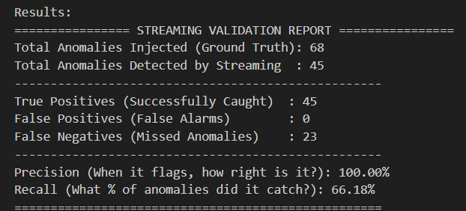
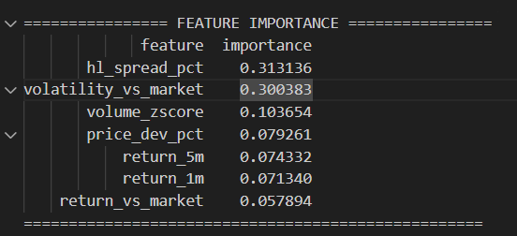
Supervised Learning - Streaming
The trained model used on streaming data.
The result seen in batch is transferred to Streaming as well.

Slide 26
Plan for next week (28 June to 4 July)
Current training of model was on subset of data. Will try using the entire dataset to see if it has better impact of the result
Hyperparameter Tuning for Higher Recall
Try getting better features
Will try with different basic models, DL and LLM

